Slide 1
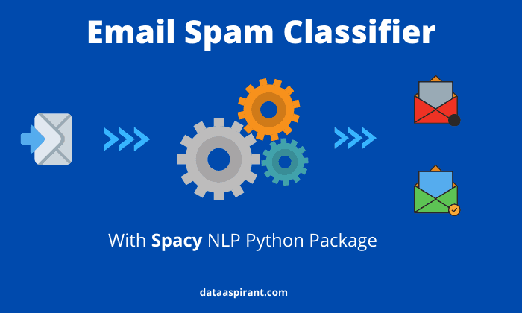
Text Classification for Email Filtering

Slide 2
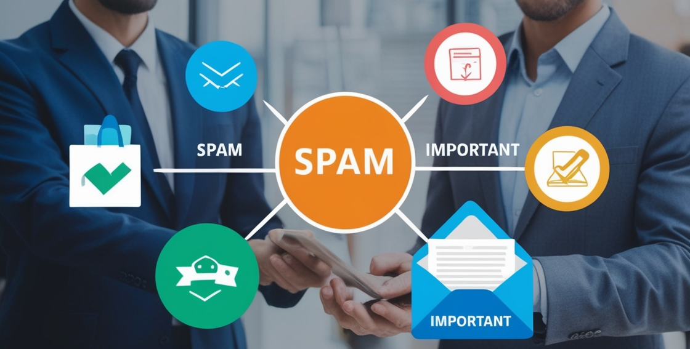
Scenario
You work for a company that wants to automatically classify incoming emails into categories such as "Spam" and "Important" to streamline email management. You have been provided with a dataset of email texts and their corresponding categories.

Slide 3

OBJECTIVE
Build a text classification model to classify emails into the specified categories. This task will involve data preprocessing, feature extraction, model training, and evaluation.

Slide 4
Libraries Needed in Project
In this project we have use number of popular libraries of all of them are listed below
Pandas:
Pandas is a powerful Python library designed for data manipulation and analysis, providing flexible data structures like DataFrames and Series. It offers tools for data cleaning, transformation, and statistical analysis.
. NLTK:
NLTK (Natural Language Toolkit) is a powerful open-source library in Python for natural language processing (NLP). It provides easy-to-use interfaces and tools for tasks such as tokenization, part-of-speech tagging, stemming, lemmatization, parsing, and text classification.
. Scikit-learn:
Scikit-learn is a popular open-source machine learning library for Python. It provides a wide range of tools for tasks such as classification, regression, clustering, dimensionality reduction, model selection, and preprocessing of data.
Matplotlib:
It is a foundational Python library for creating static, animated, and interactive visualizations. It provides control over plot elements like axes, labels, and figure size, making it highly customizable.
Seaborn:
Built on top of Matplotlib, Seaborn simplifies the creation of attractive statistical plots. It offers a high-level interface for drawing informative graphics like heatmaps, bar plots, and pair plots with minimal effort.
Plotly:
A versatile library for creating interactive, web-based visualizations. Plotly supports a wide range of charts (e.g., line plots, bar charts, 3D graphs).

Slide 5
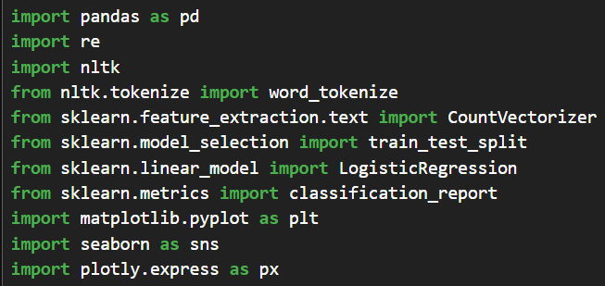
Import the Necessary Libraries
Start by importing libraries such as Pandas to read your dataset into a dataframe and data manipulation, scikit-learn for classification, regression, clustering the data and NLTK for natural language processing and to provide user easy to use interface. Matpoltlib,Seaborn,Plotly from graphical representation like charts, graph and e.t.c.To import library we “import” command.
Syntax: Import pandas as pd

Slide 6
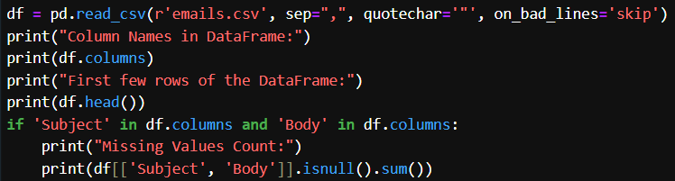
Load The Csv file and Check the Missing Values
Load the csv file to the pandas data frame and show some the rows to understand the content inside the csv file and check the null value in the file and also show the data type of every coloum
To load csv file
Syntax:df=pd.read_csv(“sample_customer_feedback.csv”)
To show some content of csv file
Syntax:df.head( )
To check null values
Syntax: print(df[[‘subject’,’Body’]].isnull( ).sum( ))

Slide 7
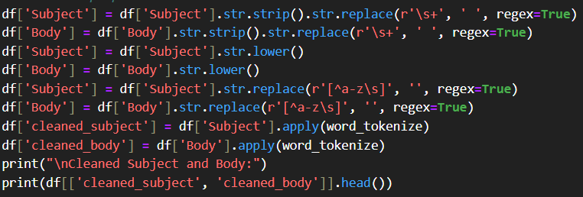
Clean and preprocess text
Clean the Comments column by Remove any extra whitespace. Convert text to lowercase. Remove punctuation. Remove any stop words. Tokenize the comments split into individual words. In this project we done these all task separately with creating a funcation.
Syntax= df[subject].str.lower()
Syntax= df[subject].str.replace(r’[^a-z\s]’,”, regex=Ture)
Syntax= df[subject]. apply(word_tokenize)

Slide 8
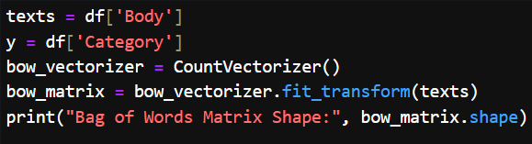
Input Data and Bag of Words (BoW) Transformation
In this we will use pandas for handling and sklearn for (Bag of matrix).
The Bag of Words (BoW) model is a simple and commonly used technique for transforming text data into numerical features that machine learning models can work with. The key idea behind the BoW model is to represent a text (document, sentence, etc.) as a collection of words, without considering their order but focusing on their frequency. and from sklearn we will use the it function sklearn.feature_extraction.text.CountVectorizer

Slide 9
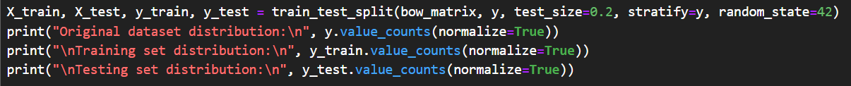
Data Splitting for Training and Testing
In this portion we will again use Pandas and Sklearn. Pandas for displaying the distribution and Sklearn for splitting the data into training and test sets. Here we will use
model_selection.train_test_split
To display data we will use pandas we will use
print(“ ", y.value_counts(normalize=True))

Slide 10
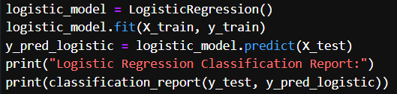
Logistic Regression Model Training
We use sklearn library for for model training and for generating the classification performance report.
Syntax= logistic_model = LogisticRegression()
Syntax=y_pred_logistic = logistic_model.predict(X_test)

Slide 11
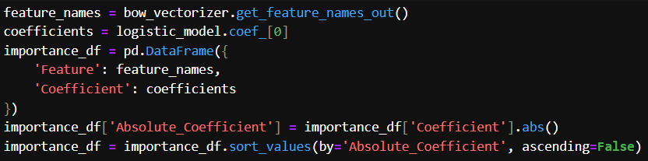
Feature Importance Extraction
Firstly we will use Pandas for creating a DataFrame to store features and their importance and Sklearn for extracting feature names.
Syntax=sklearn.feature_extraction.text.CountVectorizer

Slide 12
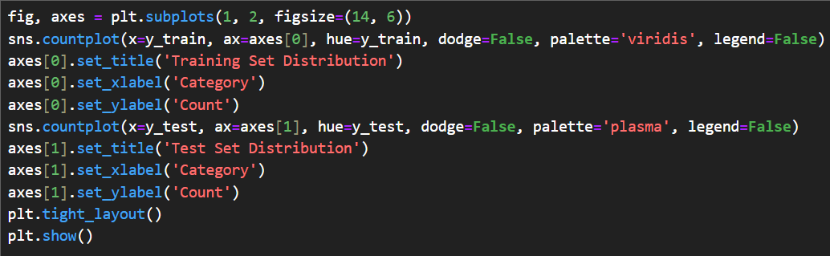
Visualization of Class Distribution
In this part we have used matplotlib and seaborn for the visualization of class distribution form matplotlib We will use plt.subplots method and from seaborn we will use count.plot method
Syntax: plt.subplots(1, 2, figsize=(14, 6))
Syntax: sns.conutplot(x=y_train, ax-axes[0], hue=y_train, dodge= false, palette= ‘viridis’ , legend=false)

Slide 13
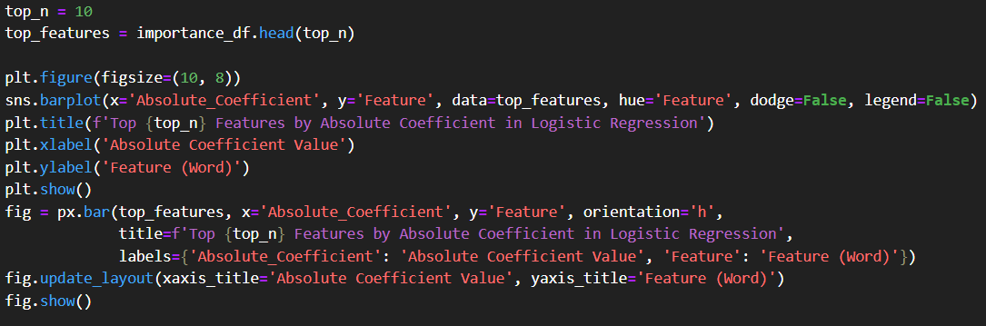
Top Features Visualization
In this code of code we visualize the figures using Matplotlib,Seaborn and Plotly. We have use Seaborn Barplot of top 10 features and Plotly for top 10 features and to update layout and show plot.

Slide 14
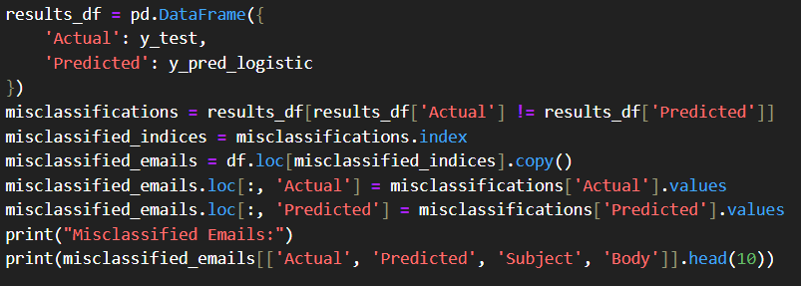
Misclassifications Handling
In this part we will use Pandas for handling data frame and data manipulation. Firstly we have to Create a DataFrame for actual and predicted labels than we have to Identify misclassified emails than we will add Actual and Predicted columns for comparison and than we will Display misclassified emails.

Slide 15

Conclusion
The code successfully implements a text classification model to classify emails as either "Spam" or "Important" using the Bag of Words (BoW) method for feature extraction and Logistic Regression for classification. After preprocessing and cleaning the text data, the model achieves solid performance, and important features are visualized for interpretation. Misclassified emails are reviewed to gain insights into potential improvements.

